Slide 1



Slide 2
DUST IN MINES
Most mining operations produce dust which, when air-borne, becomes a serious hazard to the health of the persons exposed to such an environment
.

Slide 3
2
The problem of dust has been there ever since the mining started, but in recent times, with the increase of mechanization in mines, it has become aggravated, since machine operations usually generate dust in larger quantities and get air borne than manual operations earlier.

Slide 4
3
Dust can be defined as finely divided solid matter
and can be considered from two aspects:
(1) its explosive properties and
(2) its harmful physiological effects.

Slide 5
4
Explosion hazard. The possibility of a dust explosion is always present in
coal mines.
Besides, inflammable dusts, as that of coal and sulphide ores can lead to disastrous explosions
Explosive dusts are outside the scope of our subject now

Slide 6
5
we confine ourselves to dusts with health hazards

Slide 7
Health risk
  Due to the inhalation of fine dust particles and their retention in the alveoli of the lungs, there is a health risk
  depends also upon exposure time and the nature of the dust, particularly its concentration and physicochemical properties.

Slide 8
7 DUST IN MINES
Dusts of any kind when inhaled in large quantities lead to the development of respiratory diseases. Like
Chronic bronchitis and pneumoconiosis.

Slide 9
8
Pneumoconiosis is a general term
used for occupational Lung disease due to dust and has been redefined by the ILO working group in 1971
as the accumulation of dust in
the lungs and the reaction of dust to the lung tissue.

Slide 10
9
Besides ,these dusts, radioactive dusts of uranium or thorium ores as well as other toxic dusts of ores (mainly oxides and carbonates of beryllium, arsenic, lead, chromium, vanadium, mercury, cadmium, antimony, manganese, tungsten, nickel, silver etc.) are also harmful to the human system and have to be guarded against

Slide 11
PHYSIOLOGICAL EFFECTS OF MINE DUST
Inhaled air passes through the nose and throat into the trachea,
divides into two main branches, one going to each lung.
The left lung is divided into two lobes whereas the right is divided into three (Fig.).
These lobes are made up of a vast number of small alveoli (air sacs), each of which is the termination of the branches of the trachea known as the bronchi and bronchioles.

Slide 12
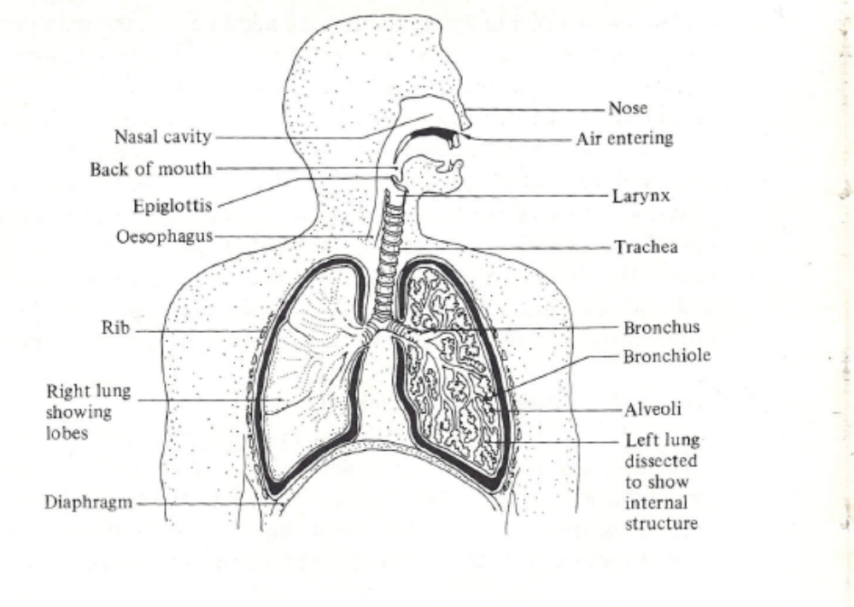
Human respiratory system

Slide 13
12
Each alveolus is supplied with arterial and venous capillaries and a lymphatic duct.
The respiratory tract has a number of defense mechanisms to catch any dust which may be inhaled.

Slide 14
13
The larger particles (>10 micro meters) are likely to he caught in the nasal passages or throat.
Some of the particles passing , through the trachea and bronchi are caught in their mucous secretions.
This mucus is continually pushed upwards by numerous minute hairs (cilia), which work with a whip-like action, at about 1.25 cm a minute until it is discharged from the trachea.

Slide 15
14
The remaining smaller particles (mostly <5 micro meters) may pass into the small alveoli. Here the mobile scavenger cells known as macrophages can engulf the particles and move into the bronchi to be ejected by the cilia.
Other particles may, however, pass through the alveolar wall and remain in the lung tissue, or enter the lymphatic drainage system via the macrophages and reach the lymph glands which function as filters.

Slide 16
15
Depending on the nature of the dust, a fibrotic reaction may take place within the lung tissue surrounding the dust particle. (Silica, asbestos, coal, diatomaceous earth, and silicates such as talc, kaolin and mica are known to produce fibrotic pneumoconiosis.)

Slide 17
16
Lastly, many particles «1 micro meter remain suspended in the inhaled air and are exhaled.

Slide 18
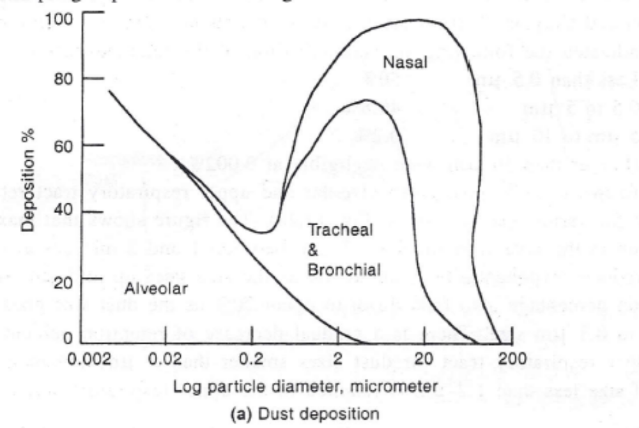
Dust deposition

Slide 19
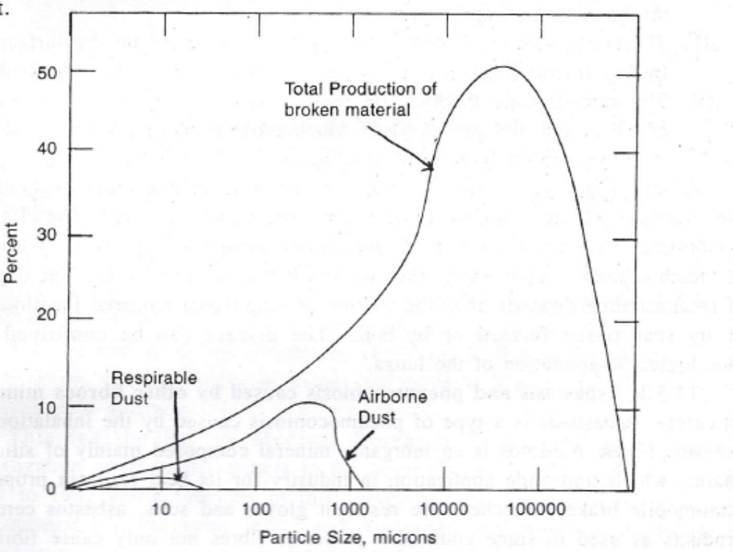
Typical size distribution of air borne dust
air-borne dust

Slide 20
concentration of dust
All the defense mechanisms are neither completely nor immediately effective so that the retention period of inhaled dust may range from hours to months.
Where excessive concentrations of dust are encountered
for long periods, the risk of a pathological response is greatly increased as defense mechanisms become overloaded.
These pathological changes may alter the normal physiology, Leading 'to a further deterioration in respiratory defense mechanisms and creating a condition of less effective lung clearance as the exposure continues.

Slide 21
20
With the deterioration of the lung tissue, pulmonary function is damaged. The symptoms may range from a shortness of breath to problems of oxygen and carbon dioxide diffusion or blood circulation, i.e. progressive diminution of working capacity, and eventually complete incapacity There is also an increased susceptibility to tuberculosis.

Slide 22
21
Pulmonary function tests and radiological examinations have been coupled with industrial hygiene studies throughout the world in the past 75 and odd years. (Radiological examinations are usually relied upon for detection and classification of the lung disease into various stages.)

Slide 23
22
Threshold limit values (TLVs) of dust concentrations have been determined from the correlation of dust concentrations and medical findings.

Slide 24
Factors affecting the degree of health risk ,Physiological properties of dust
The properties of dust affecting the development and severity of lung diseases are:
(a) composition,
(b) size, and
(c) concentration.

Slide 25
Composition.
Free silica (also called crystalline silica comprising quartz, tridymite and cristobalite) is the most dangerous component of dust affecting the behaviour of alveolar macrophages.
When these cells die they release a substance which is foreign to the body, producing an allergic type of reaction resulting in fibrosis.

Slide 26
25
it is the composition of the dust reaching the lung and not
the airborne dust which is important, since the composition of these two dusts
can vary considerably

Slide 27
26
Free silica in crystalline form in any dust is the most important factor accepted as the hazard component of any dust.
It can associate with any type of pneumoconiosis disabling.
For any physiological study assessment of silica is important

Slide 28
SIZE
By examinations of the lungs of numerous
workers, it has been determined that pneumoconiosis is caused by dust
particles below 5 ,micro meters
There is some evidence that the greatest danger is from particles ranging from
1 to 2, micrometers in size.

Slide 29
28
Only particles within the size range of about 0.25 to 10 micrometers (called respirable dust) enter the lung and only a percentage (depending upon the size of the particle and the person's retention characteristics) of those entering the lung are retained

Slide 30
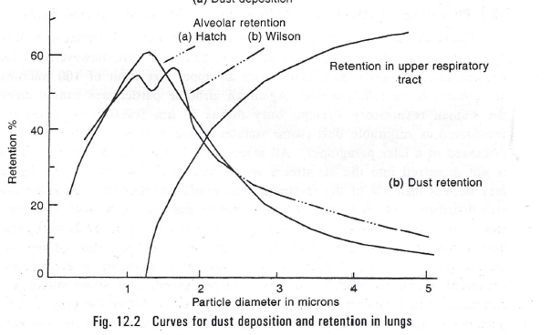
Retention of dust in respiratory tract

Slide 31
30
In general, Irregular particles settle more slowly than spheres of the same mass and for this reason irregular particles having a mass greater than that of a 10 micro meter diameter unit density sphere can be found in the lung. In some cases this effect can be serious.

Slide 32
31
Asbestos can break readily into bundles of fibers having a diameter of only 0.02 to 0.12 micrometer with a length of 1 to 150 micrometers.
Because of their very low sedimentation rate (depending upon the diameter), these fibers are not caught in the respiratory tract and are able to reach the lung
where they are retained.

Slide 33
32
Chrysotile has curved fibers and these are less likely to pass through the respiratory tract; it is probably for this reason that chrysotile is less likely to cause lung damage than amosite or crocidolite.

Slide 34
concentration
a. Concentration of dust can be expressed as mass of dust per unit volume of air,
b. number of particles per unit volume, and
c. surface area of particles per unit volume.

Slide 35
34
The mass concentration of respirable size range dust is the best single parameter to measure for assessment of the risk of pneumoconiosis from coal dust.
For quartz dust, the surface area of the respirable particles is probably the best parameter to measure
it is usually measured with a gravimetric dust sampling instrument.

Slide 36
35
Surface area more important for the reactivity of silica dust and toxic nature

Slide 37
Time of exposure
The human respiratory system has a certain capacity for disposing of inhaled dust.
Under overloaded conditions, larger lung dosages produce faster development of pneumoconiosis.
Thus, the time of exposure to a certain dust concentration is an important factor in the development of pneumoconiosis.

Slide 38
37
The incidence of pneumoconiosis increases with increase in both the concentration and
time of exposure and is correlated with the cumulative
dust exposure calculated from the length of employment of the worker and
the weighted average concentration of dust to which the worker is subjected on each shift.

Slide 39
Threshold limit values
Thresh hold limit values of air borne substances are those concentrations within which nearly all workers may be repeatedly exposed day after day without any adverse effect on their health.

Slide 40
33 PNEMOCONIOSIS
From a pathological point of view, pneumoconiosis can be divided into two groups:
(a) collagenous, and
(b) noncollagenous.

Slide 41
34
Non collagenous pneumoconiosis is caused by non fibrogenic dusts and is characterized by
1) alveolar architecture remaining intact,
2) minimal stromal reaction consisting mainly of reticulin fibers and
(iii) reversibility of dust reaction. .

Slide 42
35
Examples of noncollagenous pneumoconiosis. are
stannosis caused by tin oxide and
barytosis caused by barium sulphate.

Slide 43
36
Collagenous pneumoconiosis is characterized by
(i) permanent alteration or destruction of alveolar architecture,
(ii) collagenous stromal reaction of moderate to maximal degree and
(iii) permanent scarring of lungs.
It may be caused by fibrogenic dusts or altered tissue response to non-fibrogenic dusts.
collagenous

Slide 44
37
In practice distinction between collagenous and noncollagenous pneumoconiosis is difficult and continued exposure to the same dust such as coal dust may cause transition from
non- collagenous to collagenous form

Slide 45
SILICOSIS
Of all the types of pneumoconiosis met with in mines, silicosis is the most dangerous since it can affect people fatally and is progressive in nature.
There have been cases when a patient has complained of the symptoms of silicosis even after he had left the dusty operation for several years.

Slide 46
39
Silicosis is characterized by the development of nodular fibrosis in the lung tissue.
The nodules appear as protrusions in the lung tissue and histologically consist of a concentric development of fibrous tissue.
They may at times be thrown into sharp relief by emphysema or collapse of the surrounding lung tissue.
Calcareous development at the centre of the nodules is noticed in certain cases.

Slide 47
40
Pathologically and symptomatically silicosis can be divided into the following three stages.

Slide 48
41
In the first stage dyspnoea (inelasticity of the lung) and shortening of breath is noticed only on exertion.
There may be a slight dry cough but chest expansion is rarely minimized. Radiographs of the
Radiographs of the lung show discrete circular shadows of nodules of a maximum diameter of 2mm.

Slide 49
42
The second stage is characterized by well-established dyspnoea and cough with impaired chest expansion.
The radiograph shows diffuse nodulation with a tendency to coalescence.
Dyspnoea leads to total incapacity

Slide 50
43
In the third stage when
the radiograph shows areas of massive consolidation.

Slide 51
44
Silicosis, particularly in the advanced stages, is usually associated with tuberculosis infection which may modify the symptoms.

Slide 52
45
The cause of nodular fibrosis is believed to be the toxic action. of high polymers of silicic acid.
Particles of free silica (Si02) dissolve in the lung fluid forming silicic acid which, in turn, under- goes high polymerization when the initial pH(2) of silicic acid passes through a value of 5.5 to 6 corresponding to a stage of high polymerization of silicic acid as it tends to reach the lung pH of 7. .

Slide 53
47
There has been no approved cure, so far, of silicosis, though its associated tuberculosis is amenable to treatment:
Aluminum prophylaxis and therapy for the treatment of silicosis have been tried in Canada and some other countries since 1937 with encouraging results, but they have yet to find wide application .(in mines).

Slide 54
47
The principle of aluminum therapy depends on the fact that particles of metallic aluminum or amorphous hydrated alumina when engulfed in the same phagocyte cell along with silica dust neutralize the effect of silica, thus arresting further progression of fibro tic tissue reactions.
Mature nodules become static and immature lesions of the early stage of fibrosis get resolved.

Slide 55
48
Aluminum ordinarily has no toxic effect on lung tissue but excessive doses make the lung more susceptible to tuberculosis infection.
Aluminum dust is retained in the lung for a fairly long time extending even up to a year, and can hence act as a prophylactic agent against later inhalation of silica dust.

Slide 56
49
Recently" aqueous solution of chlorhydroxy-allantoinate of aluminum and colloidal solution of aluminum hydroxide administered in the form of aerosol showed both prophylactic as well as stabilizing action on silicotic lesions, while the solution itself was completely innocuous.

Slide 57
50
Experiments have been carried out in Germany for preventing dangerous silica dust from reaching the alveoli of the lung (where they could produce silicosis) by artificially increasing their size.
This is done by releasing a large quantity of fine aerosol (0.05 Micro.m size) of sodium chloride into the dusty air

Slide 58
51
Owing to Brownian motion, several particles of sodium chloride coagulate with each dust
particle. The hygroscopic salt absorbs moisture when passing .through the moist respiratory tract and makes the dust particles grow in size by condensation of water on them.
Though encouraging results have been obtained from experiments on animals, the effect of the method on m en has not yet been fully tried out.

Slide 59
52 ASBESTOSIS
Owing to Brownian motion, several particles of sodium chloride coagulate with each dust
particle. The hygroscopic salt absorbs moisture when passing .through the moist respiratory tract and makes the dust particles grow in size by condensation of water on them.
Though encouraging results have been obtained from experiments on animals, the effect of the method on m en has not yet been fully tried out.

Slide 60
53
The lung radiograph shows a diffuse ground glass Of cobweb-like appearance.
Here the fibrosis is believed to be caused by the mechanical action of long asbestos fibers which get lodged in the alveolar walls causing morbid growth of fibrous tissue in the region.

Slide 61
54
As a result, the alveolar walls or the septa separating alveoli get thickened owing to the presence of both asbestos fibers and asbestosis bodies.
This is substantiated by the fact that the fibrosis-producing character of asbestos is almost completely eliminated if the asbestos is thoroughly pulverized so that no particle in it exceeds two icrometers in length.

Slide 62
55
Emphysema is usually present in asbestosis with many pleural adhesions.
The Common symptoms of asbestosis are dyspnoea and non-productive cough.

Slide 63
56
Often the clinical symptoms may be more pronounced than those in classical silicosis although the lung radiographs of asbestosis are less severe than those of classical
silicosis.
Progress of fibrosis in asbestosis has been found to be more rapid than in silicosis, so much so that a person may die of asbestosis within five years of the onset of symptoms.
Asbestosis, however, makes the lung less susceptible to tuberculosis than does silicosis

Slide 64
57
Apart from dusts of free silica and asbestos, other dusts such as that of chromite, iron ore, kaolin, barytes etc. produce pneu-mokonioses which usually do not show fibrosis and are generally non-progressive and non-disabling, though pigmentation and
consequent thickening of alveolar walls do occur.
Fibrosis however develops if these dusts contain some amount of free silica.

Slide 65
COAL MINERS PNEMOCONIOSIS
In the simplest form of coal miners' pneumoconiosis, coal dust usually collects at a number of foci all over the lung around the small bronchioles and their accompanying arteries and a network of reticulin fibres is developed all around these foci. The air spaces around the coal foci get dilated leading to focal emphysema.

Slide 66
standards
from their study of particulate residues of lung digests have indicated the following size classification of the retained dust-
Less than 0.5 micrometers 50%
0.5 to 5 micrometrers 49.8%
5.0 to 10 micrometers 0.2%
(Larger than 10 micrometers were negligible at 0.002%).

Slide 67
Standard of dust concentration
1. Precautions against air-borne dust Circular Technical 16 of 1975 gave tentative standards for air borne dust.
it was recommended that the average concentration of respirable
dust in mine atmosphere during each shift, to which each miner is exposed
at any working point or place,
shall not exceed 3 mg/m3 where the free silica in air borne dust is 5% or less.
Where the dust contains more than 5% quartz or free silica, the limiting value was required to be determined by the following formula-
Permissible concentration = . 15 mg/m3 air-borne dust % respirable quartz or free silica
. _.0 Recent dust surveys by R & D wing of DGMS revealed that concentration
Z air-borne dust at working places in mechanised mines, whether opencast

Slide 68
Standards of dust concentration

